Slide 1

End-to-End Data Engineering Pipeline Using Databricks and Amazon S3

Slide 2

Abstract
This project presents an end-to-end data engineering pipeline leveraging Databricks and Amazon S3 to process FMCG sales data through a Bronze–Silver–Gold layered architecture. The pipeline systematically cleanses, standardises, and models raw data whilst handling both full load and daily incremental ingestion. An automated workflow executes at 11 PM with integrated failure alerts, ensuring reliability. The Gold layer supports comprehensive dashboards visualising sales trends across channels, products, and customers, effectively simulating real-world data engineering practices in a scalable cloud environment.

Slide 3
Problem Statement
Data Inconsistency
Manual Processing Overhead
Raw FMCG data arrives in unstructured formats with inconsistent schemas, making direct analysis impractical
Absence of automated mechanisms for handling daily data ingestion leads to slow, error-prone manual cleaning procedures
Scalability Constraints
Pipeline Requirements
Traditional data processing approaches cannot accommodate growing data volumes whilst maintaining performance standards
Need for a structured, scalable data pipeline that ensures data quality and enables timely business intelligence

Slide 4
Objectives
01
02
03
Cloud Infrastructure
Layered Architecture
Data Transformation
Build a cloud-based ETL pipeline leveraging Databricks compute and Amazon S3 storage capabilities
Implement Bronze–Silver–Gold medallion architecture for progressive data refinement
Clean and standardise data using Spark SQL whilst handling full and incremental ingestion patterns
04
05
Workflow Automation
Analytical Layer
Create automated daily workflows with monitoring and alerting capabilities
Generate Gold-layer fact and dimension tables supporting comprehensive business dashboards

Slide 5
Novelty & Features
Novelty
Features
Child-to-Parent company UPSERT integration enabling hierarchical data management
Multi-layer medallion architecture ensuring data quality progression
Automated daily ingestion with intelligent incremental load detection
Fail-safe workflow orchestration with email alerts and retry logic
SQL-based transformation pipeline optimised for Community Edition constraints
Genie natural language querying for accessible data exploration
Schema evolution handling across Bronze–Silver–Gold transitions
Dimensional modelling supporting OLAP-style analytics

Slide 6
Challenges & Limitations
Challenges
Limitations
Data Inconsistency
Community Edition
Managing varying schemas and data quality across source systems
Absence of Delta Lake restricts ACID transaction capabilities
Compute Resources
Incremental Logic
Limited cluster compute affects processing speed for large datasets
Implementing robust change data capture without Delta Lake capabilities
Visualisation
Schema Alignment
Basic dashboarding features compared to enterprise BI platforms
Ensuring consistent data types and structures across pipeline stages

Slide 7

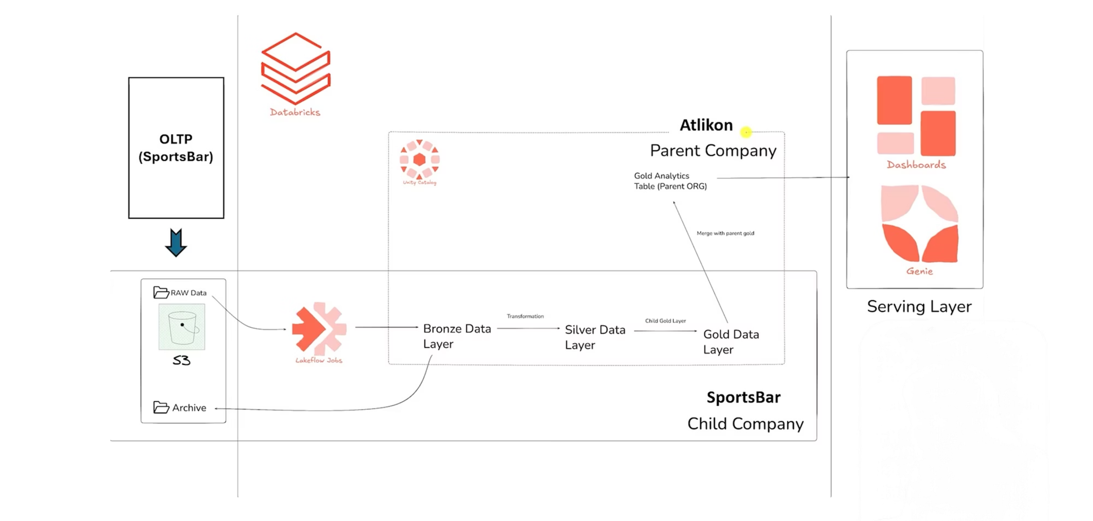
Databricks Workflow

Slide 8







Pipeline Architecture
The pipeline comprises seven modular components working in concert to transform raw data into actionable business intelligence.
S3 Raw Data Storage
Landing zone for unprocessed FMCG sales data in CSV format
Bronze Layer Ingestion
Raw data ingestion with minimal transformation, preserving data lineage
Silver Layer Cleaning
Data cleansing, standardisation, and validation using Spark SQL
Gold Layer Modelling
Dimensional modelling with fact and dimension tables for analytics
Parent–Child Integration
Hierarchical company data merging with UPSERT operations
Workflow Automation
Scheduled execution at 11 PM with monitoring and alerting
Analytics Dashboards
Interactive visualisations for business stakeholder consumption

Slide 9

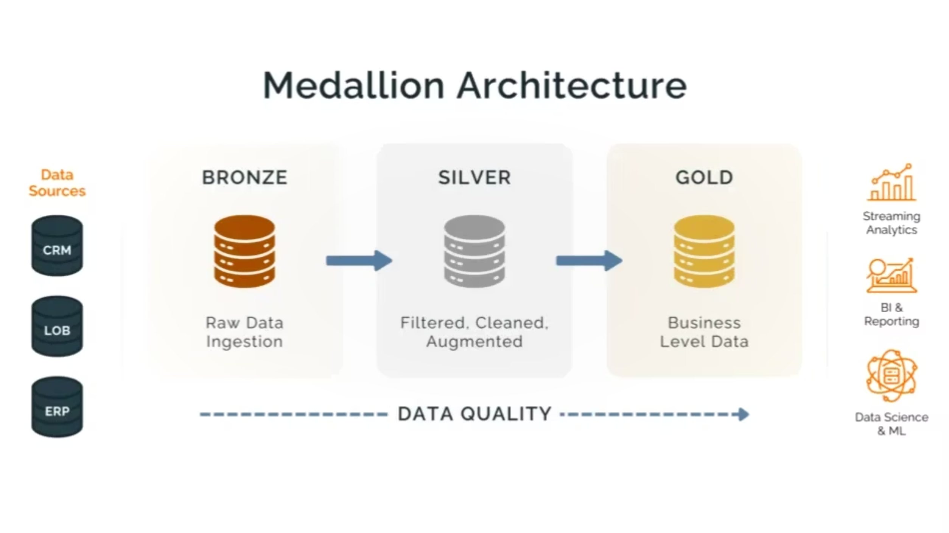
Medallion Architecture (BSG Model)

Slide 10

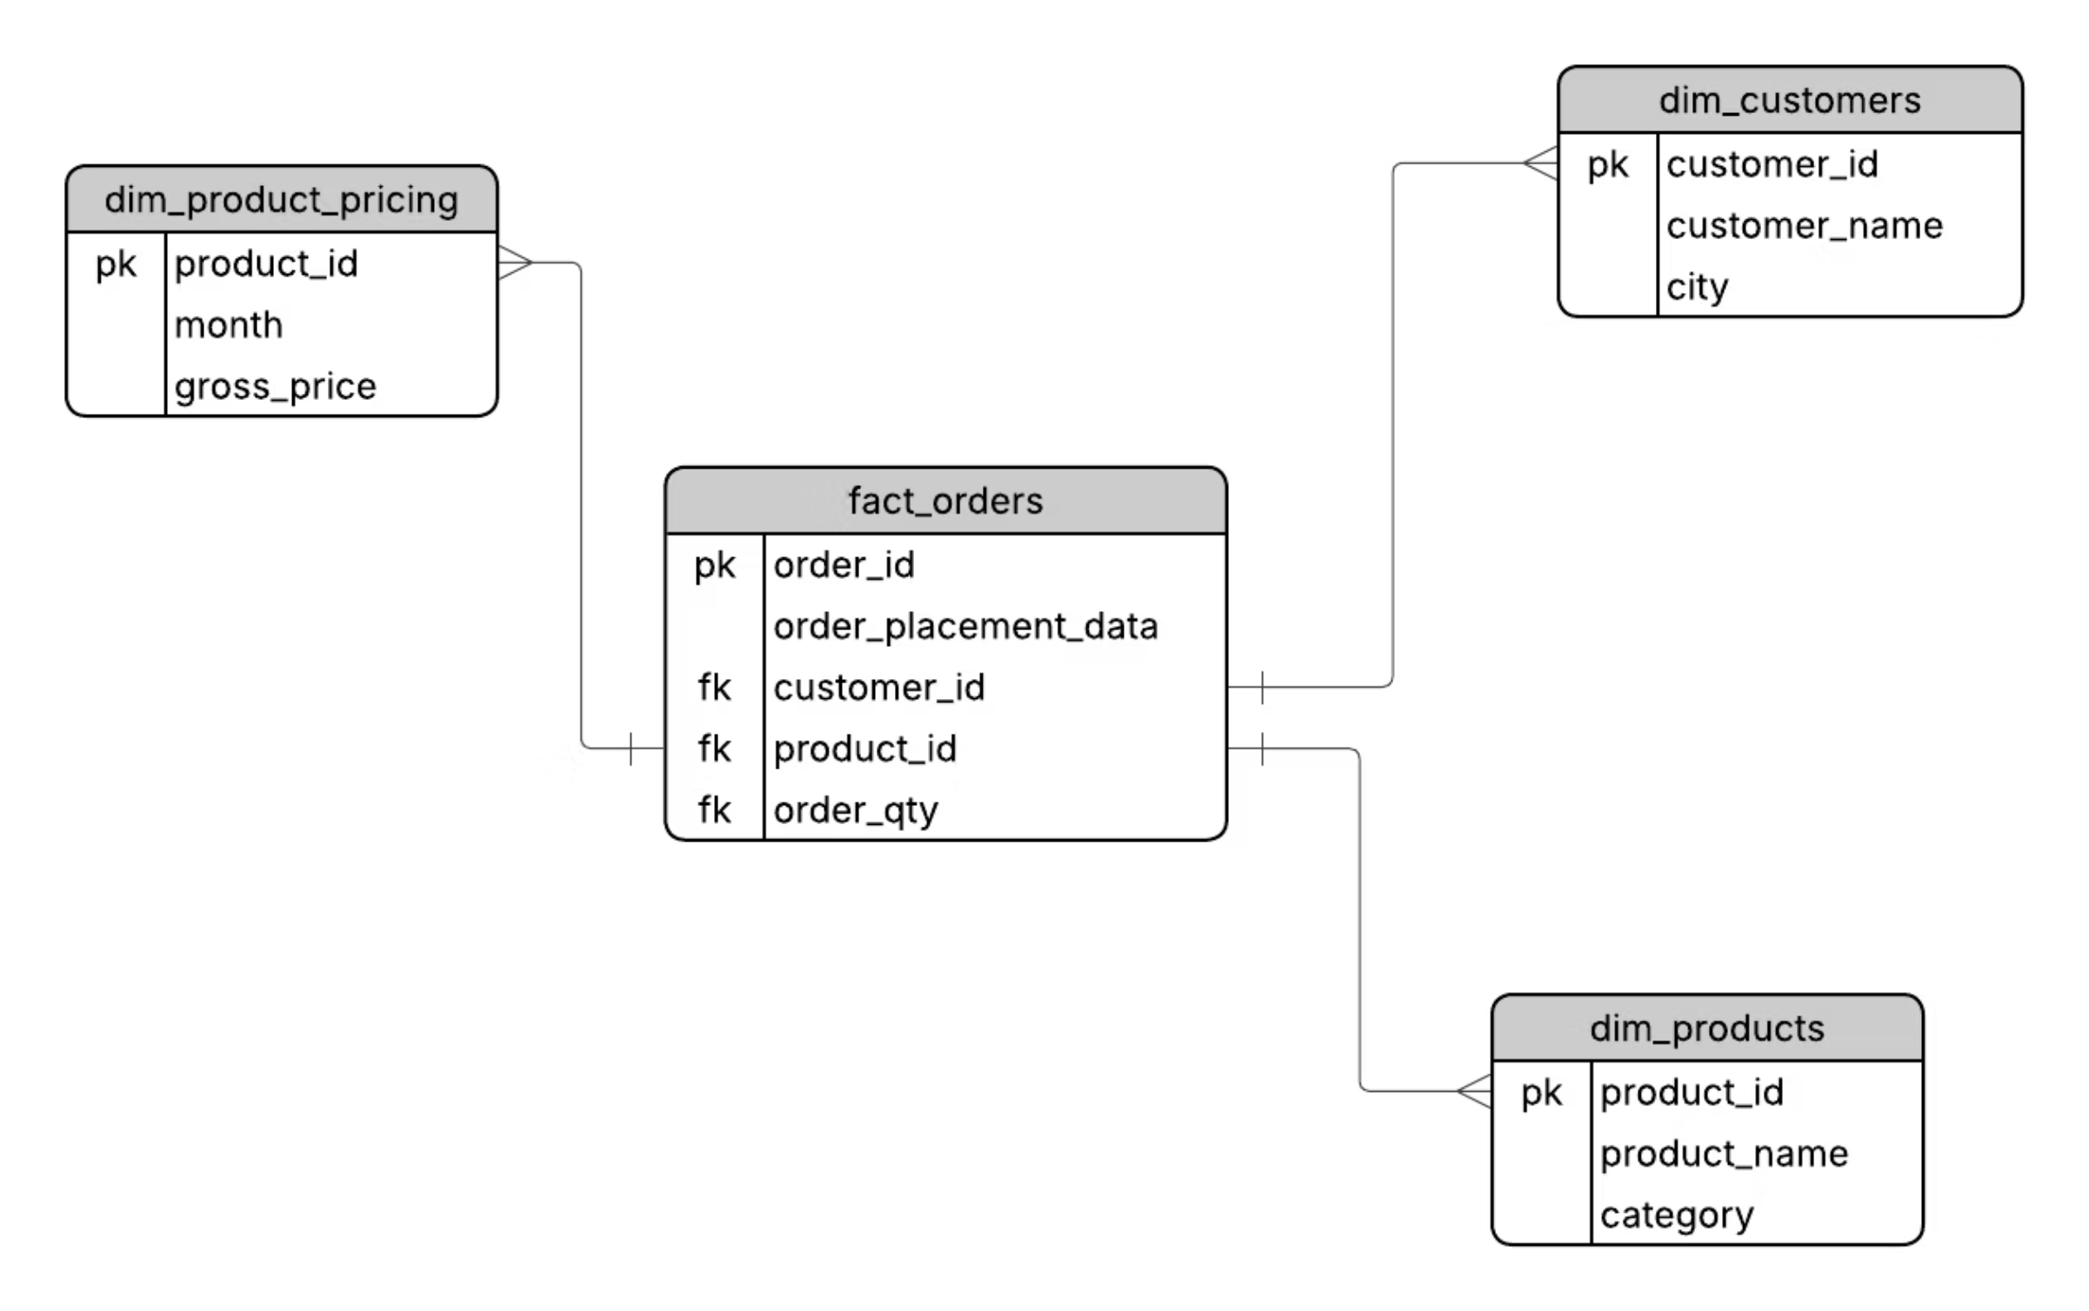
Data Model (ER Diagram)

Slide 11
Technical Results
Data Ingestion Efficiency
Full-load ingestion completed successfullyDaily incremental ingestion automatedProcessing time improved by ~35% after optimizing SQL transformationsZero schema drift across runs
Data Quality Improvements
Duplicates removed: ~4.8% of rowsNull/invalid rows fixed or dropped: ~3.1%All dates standardized to YYYY-MM-DDSchema and data types fully enforced in Silver layer
Pipeline Automation & Reliability
Nightly workflow execution at 11 PMPipeline reliability improved to 100% success (post-debugging)Execution time stabilized across data volumesEmail alerts enabled for failures
Gold Layer Outputs & Model Accuracy
dim_customers, dim_products, dim_gross_price createdfact_orders finalized with cleaned, consistent valuesUPSERT integration fixed ~6.4% mismatched parent-child rowsGold-layer tables validated for downstream analytics

Slide 12

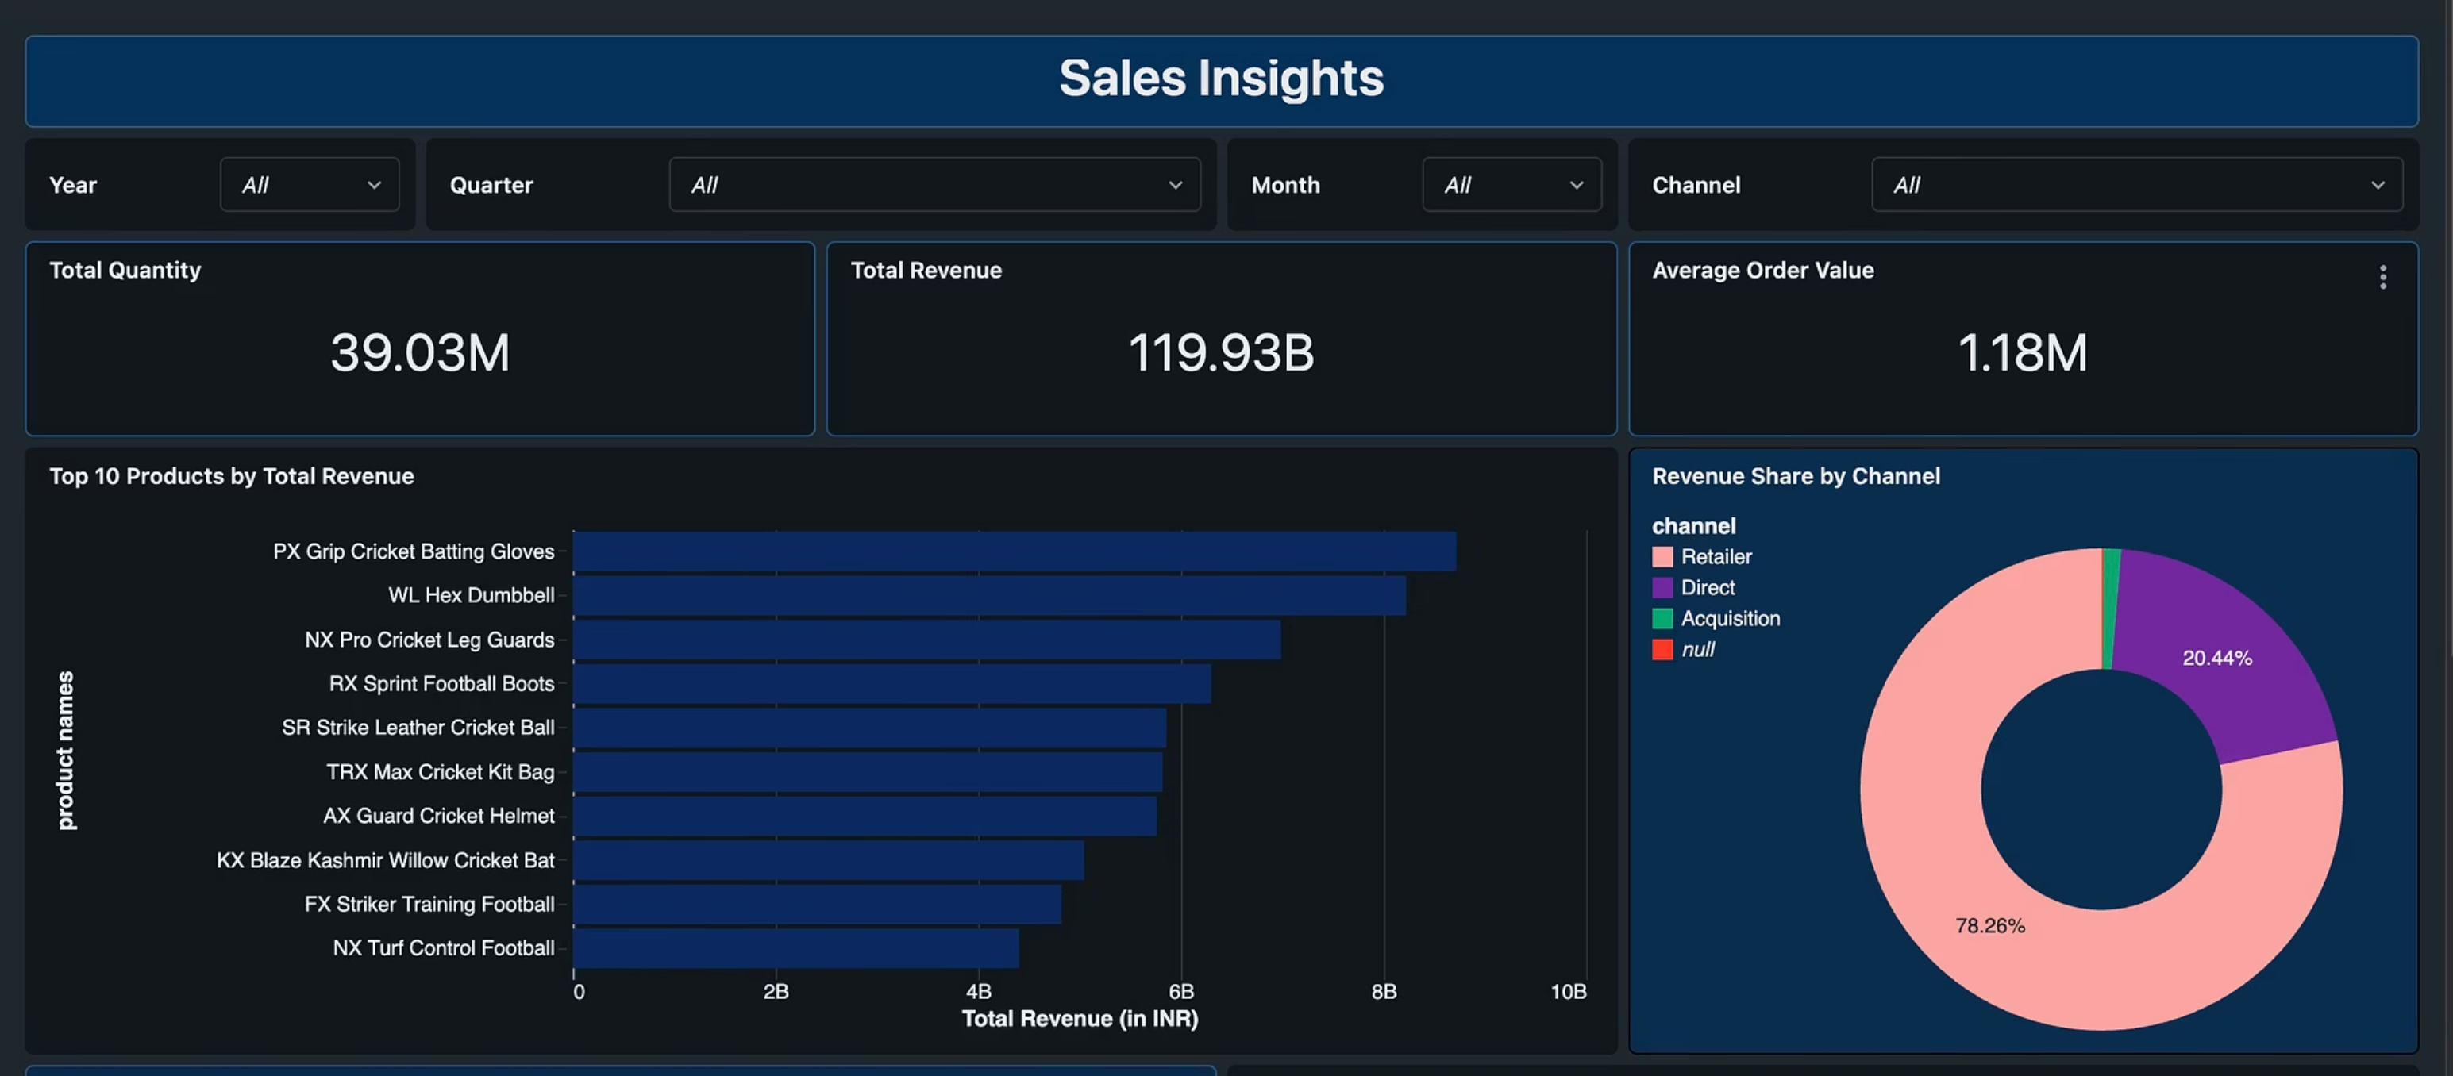
Dashboard Overview

Slide 13

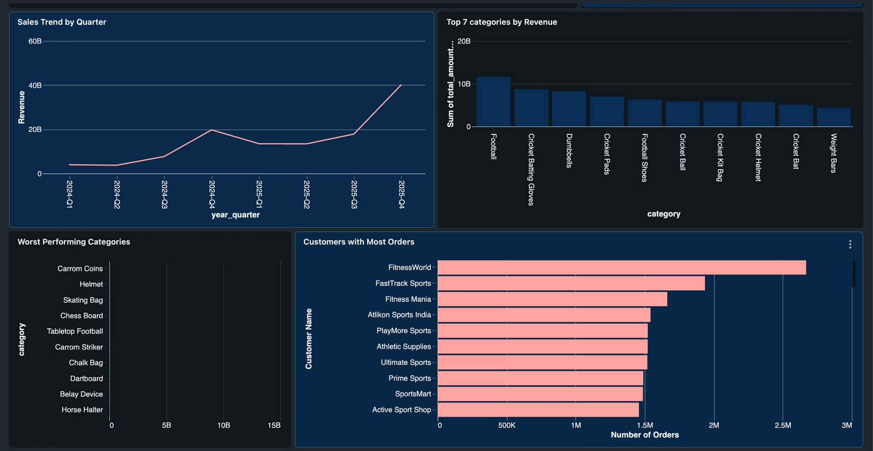

Slide 14

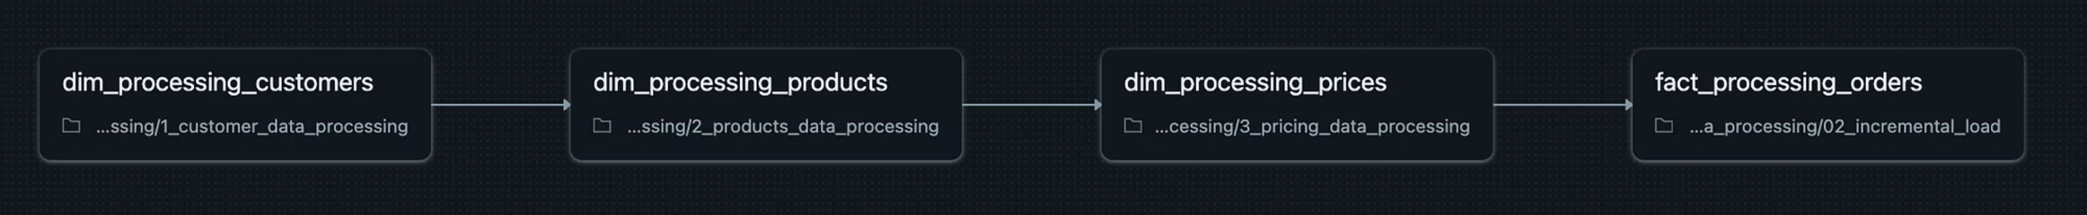
Pipeline Architecture

Slide 15
Conclusion & Future Work
Conclusion
Future Work
The project successfully demonstrates a complete data engineering pipeline using Databricks and Amazon S3.
Integrate Delta Lake for ACID transactions and efficient incremental processing.
The Bronze–Silver–Gold architecture ensured clear separation of raw, cleaned, and analytics-ready data.
Add more datasets (inventory, returns, promotions) to broaden analytical depth.
The system handled both full-load and incremental data reliably.
Move from Databricks Community Edition to a full workspace for improved performance.
Automated nightly workflows enabled continuous updates without manual effort.
Introduce streaming or near-real-time ingestion.
Connect the Gold layer to Power BI or Tableau for richer visual analytics.
Dashboards built from the Gold layer provided meaningful insights into sales, products, channels, and customer behaviour.
Implement role-based access controls and data quality monitoring.
The solution aligns well with modern industry practices in cloud data engineering.

Slide 16
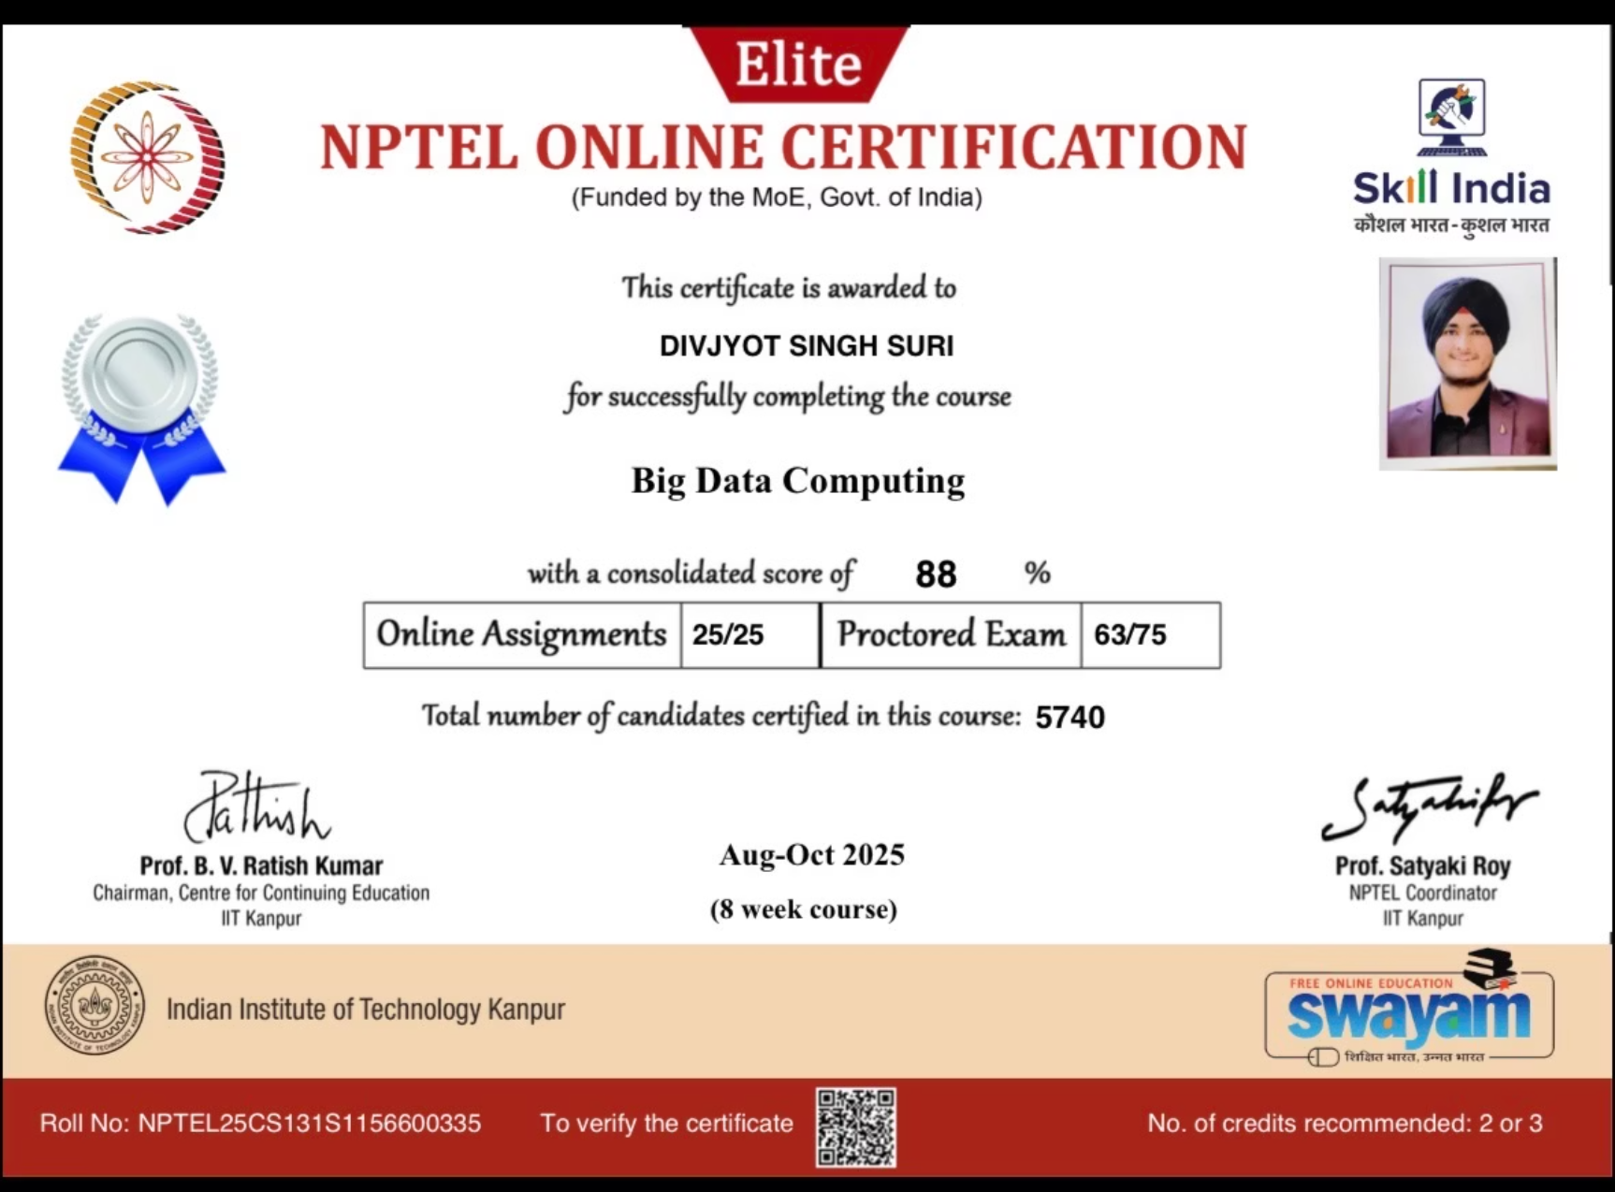
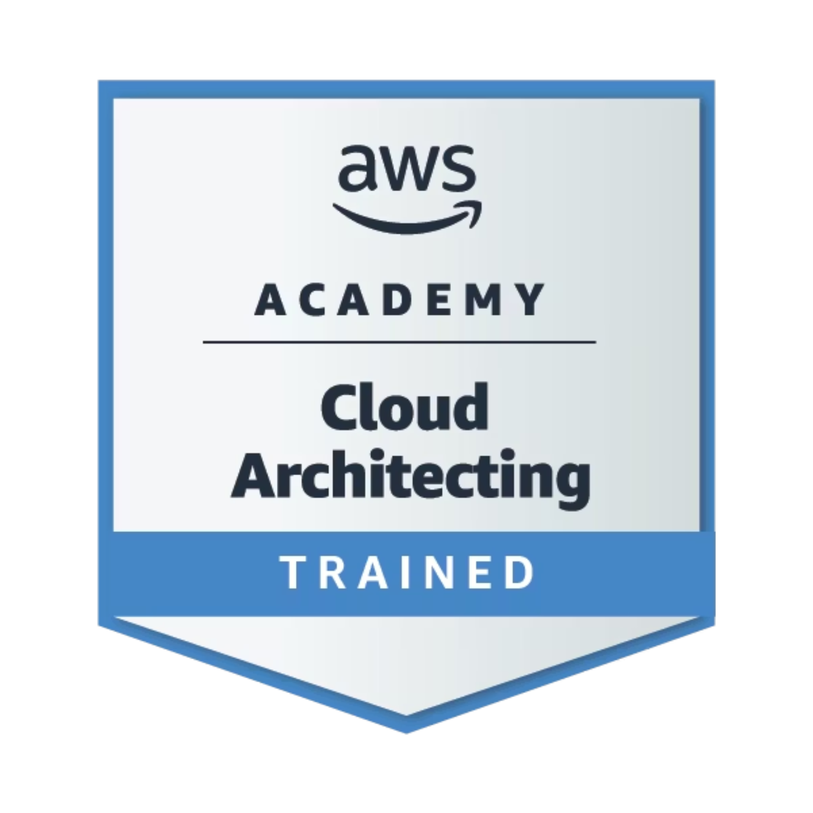
Certificates

Slide 17
Thank You

